Slide 1
C# & .NET Framework
Chapter 22
Database Access with ADO.NET

Slide 2
Review
Label, TextBox, and MaskedTextBox
Button
CheckBox, RadioButton, and GroupBox
CheckedListBox, ListBox, and ComboBox
MonthCalendar, TabControl, TrackBar, WebBrowser

Slide 3
Chapter 22: Objectives
ADO.NET Introduction.
Understanding ADO.NET Data Providers
Increasing Flexibility Using Application Configuration Files.
The .NET 2.0 Provider Factory Model
Understanding the Connected Layer of ADO.NET
Working with Data Readers
Modifying Tables Using Command Objects.
Working with Parameterized Command Objects
Executing a Stored Procedure Using DbCommand
Understanding the Disconnected Layer of ADO.NET
Binding DataTables to User Interfaces.

Slide 4
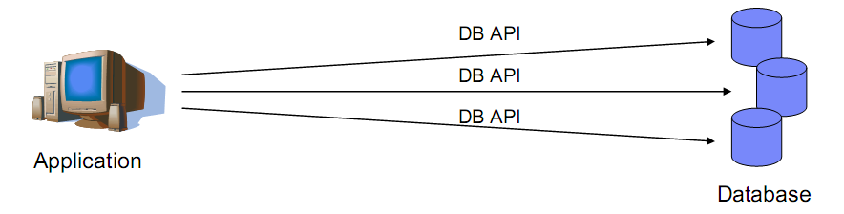
Before ADO .NET……
Native API
Notes:
A Brief History of Universal Data Access
Database management systems provide APIs that allow application programmers to create and access databases. The set of APIs that each manufacturer's system supplies is unique to that manufacturer. Microsoft has long recognized that it is inefficient and error prone for an applications programmer to attempt to master and use all the APIs for the various available database management systems. What's more, if a new database management system is released, an existing application can't make use of it without being rewritten to understand the new APIs. What is needed is a common database API.
Microsoft's previous steps in this direction included Open Database Connectivity (ODBC), OLE DB, and ADO (not to be confused with ADO.NET). Microsoft has made improvements with each new technology.

Slide 5
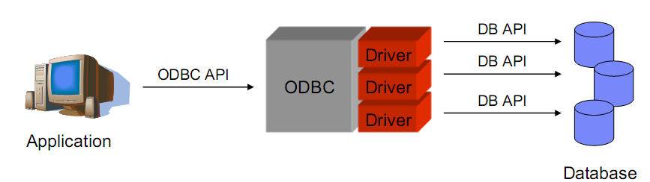
Before ADO .NET……
Open Database Connectivity (ODBC)

Slide 6
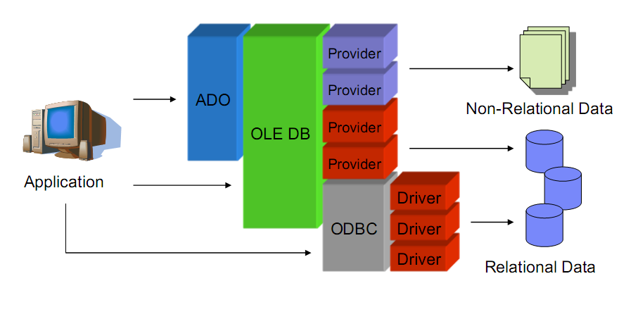
Before ADO .NET……
OLEBD and ADO (ActiveX Data Objects)

Slide 7
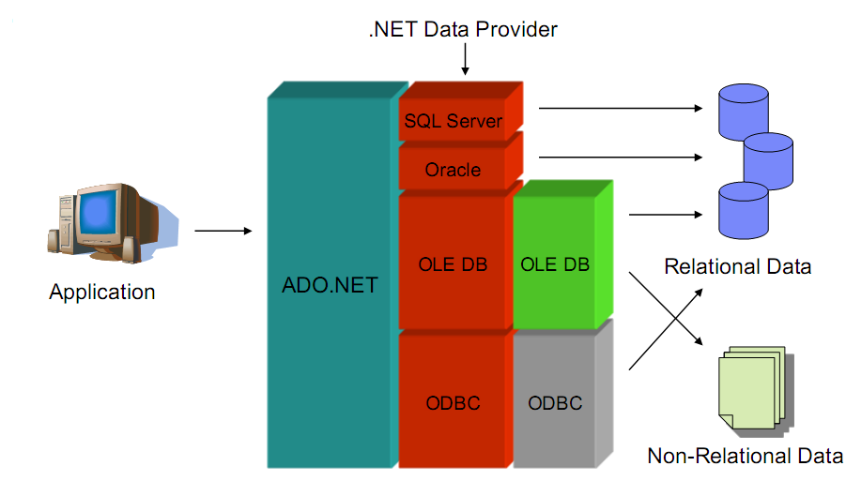
…. And ADO .NET

Slide 8
ADO.NET over ADO
In-memory Representations of Data
In ADO, the in-memory representation of data is the recordset. In ADO.NET, it is the dataset.
A recordset looks like a single table. If a recordset is to contain data from multiple database tables, it must use a JOIN query, which assembles the data from the various database tables into a single result table.
In contrast, a dataset is a collection of one or more tables. In this way, a dataset can mimic the structure of the underlying database.
Notes:
ADO .NET: Active Data Objects
ADO: ActiveX Data Objects

Slide 9
ADO.NET vs ADO
Minimized Open Connections
In ADO.NET you open connections only long enough to perform a database operation, such as a Select or Update. You can read rows into a dataset and then work with them without staying connected to the data source.
In ADO the recordset can provide disconnected access, but ADO is designed primarily for connected access.

Slide 10
ADO.NET vs ADO
Sharing Data Between Applications
To transmit an ADO disconnected recordset from one component to another, you use COM marshalling
To transmit data in ADO.NET, you use a dataset, which can transmit an XML stream: richer data types, better performance, penetrating firewalls
ADO.NET is a managed library of code

Slide 11
ADO.NET models
Connected layer:
explicitly connect to and disconnect from the underlying data store.
typically interact with the data store using connection, command, and data reader objects.
Disconnected layer:
Obtain a client-side copy of the external data (the connection is automatically opened and closed).
Interact with SqlDataAdapter, DataSet, DataTable objects

Slide 12
ADO.NET Data Providers
ADO.NET supports multiple data providers, each of which is optimized to interact with a specific DBMS.
Benefits:
A Specific data provider can be programmed to access any unique features of the DBMS.
A specific data provider is able to directly connect to the underlying engine of the DBMS without an intermediate mapping layer standing between the tiers.

Slide 13
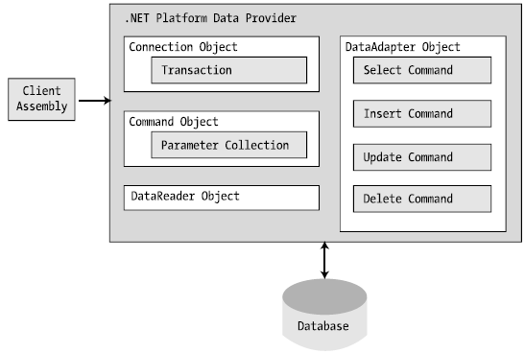
ADO.NET Data Providers
A data provider is a set of types defined in a given namespace that understand how to communicate with a specific data source.
As a naming convention, the objects in a specific data provider are prefixed with the name of the related DBMS.
Example: SqlConnection, OracleConnection, MysqlConnection.

Slide 14
ADO.NET Data Providers
Microsoft-Supplied Data Providers
OLE DB is used for interacting with a DBMS that does not define a specific.
Microsoft SQL Server offers direct access to MS SQL Server data stores.
Data Provider | Namespace | Assembly
OLE DB | System.Data.OleDb | System.Data.dll
Microsoft SQL Server | System.Data.SqlClient | System.Data.dll
Microsoft SQL Server Mobile | System.Data.SqlServerCe | System.Data.SqlServerCe.dll
ODBC | System.Data.Odbc | System.Data.dll
Oracle | System.Data.OracleClient | System.Data.OracleClient.dll
Notes:
ODBC is Open Data Base Connectivity, which is a connection method to data sources and other things. It requires that you set up a data source, or what's called a DSN using an SQL driver or other driver if connecting to other database types. Most database systems support ODBC. OLE is Object Linking and Embedding. OLEDB is partly distinguished from OLE itself, now called "automation". OLEDB is the successor (nguoi ke thua) to ODBC, a set of software components that allow a "front end" such as GUI based on VB, C++, Access or whatever to connect with a back end such as SQL Server, Oracle, DB2, mySQL etal. In many cases the OLEDB components offer much better performance than the older ODBC.

Slide 15
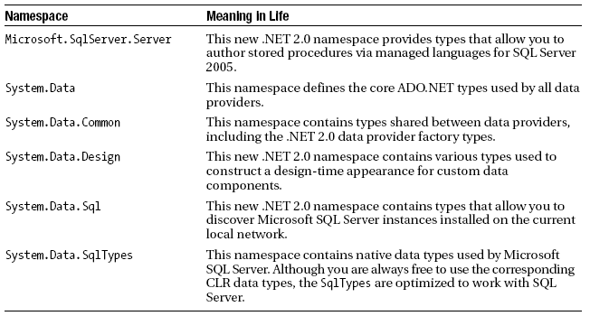
Additional ADO.NET Namespaces

Slide 16
System.Data: Common Types
IDbConnection Interface
defines a set of members used to configure a connection to a specific data store
IDbTransaction Interface
interact with a transactional session and the underlying data store
IDbCommand Interface
allow programmatic manipulation of SQL statements, stored procedures, and parameterized queries
IDbDataAdapter and IDataAdapter Interfaces
defines a set of properties that are used to maintain the SQL statements for the related select, insert, update, and delete operations
defines the key function to transfer DataSets between the caller and underlying data store using the Fill() and Update() methods

Slide 17
The .NET 2.0 Provider Factory Model
.NET 2.0 offers a data provider factory pattern that allows to build a single code base using generalized data access types.
DbCommand: Abstract base class for all command objects
DbConnection: Abstract base class for all connection objects
DbDataAdapter: Abstract base class for all data adapter objects
DbDataReader: Abstract base class for all data reader objects
DbParameter: Abstract base class for all parameter objects
DbTransaction: Abstract base class for all transaction objects

Slide 18
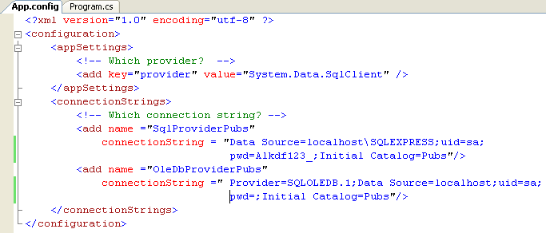
Provider Factory Model Demo (Ch_22 Code\DataProviderFactory)
Create config file to store DB Provider information

Slide 19
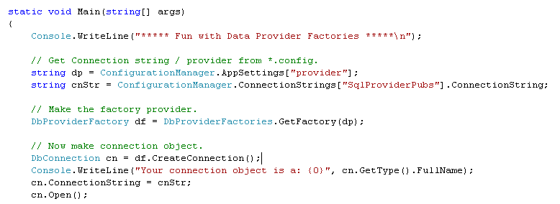
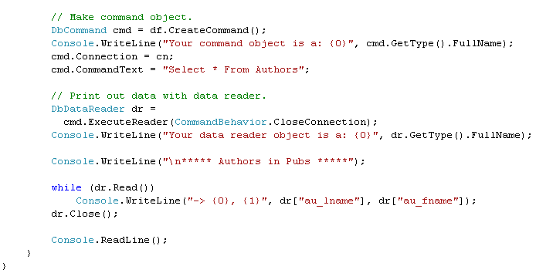
Provider Factory Model Demo (Ch_22 Code\DataProviderFactory)
Get connection info from config file
Connect to database
Create and execute query
Read returned data

Slide 20
ADO.NET: Connected Layer
The connected layer of ADO.NET allows to interact with a database using the connection, command, and data reader objects
Steps to connect to a database and read the records using a data reader object:
Allocate, configure, and open your connection object (sqlConnection).
Allocate and configure a command object (SqlCommand), specifying the connection object as a constructor argument or via the Connection property.
Call ExecuteReader() on the configured command object.
Process each record using the Read() method of the data reader (SqlDataReader).

Slide 21
ADO.NET: Connected Layer
Connection Objects (SqlConnection)
Establish a session with the data source.
ConnectionString property: identify the name of the machine you wish to connect to, required security settings, the name of the database on that machine, and other data provider–specific information.
Example: "uid=sa;pwd=;Initial Catalog=Cars; Data Source=(local)";

Slide 22
ADO.NET: Connected Layer
Command Objects (SqlCommand)
The SqlCommand,which derives from DbCommand, is an OO representation of a SQL query, table name, or stored procedure.
The type of command is specified using the CommandType property, which includes:
StoredProcedure: The name of a stored procedure.
TableDirect: The name of a table.
Text: An SQL text command. (Default.)
Member | Description
CommandTimeout | Gets or sets the time to wait while executing the command before terminating the attempt and generating an error. The default is 30 seconds.
ExecuteNonQuery() | Issues the command text to the data store (Update, insert, delete).
ExecuteReader() | Returns the data provider’s DbDataReader object, which provides forward-only, read-only access to the underlying data.
ExecuteXmlReader() | Returns result sets as XML
Notes:
TableDirect is only supported by the .NET Framework Data Provider for OLE DB. Multiple table access is not supported when CommandType is set toTableDirect.

Slide 23
Modifying Tables Using Command Objects
The ExecuteReader() method extracts a data reader object using a forward-only, read-only flow of information.
The ExecuteNonQuery() method of command object will perform inserts, updates, and deletes based on the format of command text.

Slide 24
SQLConnection SQLCommand SQLCommandBuilder SQLDataAdapter DataTable
Demo BookStore

Slide 25
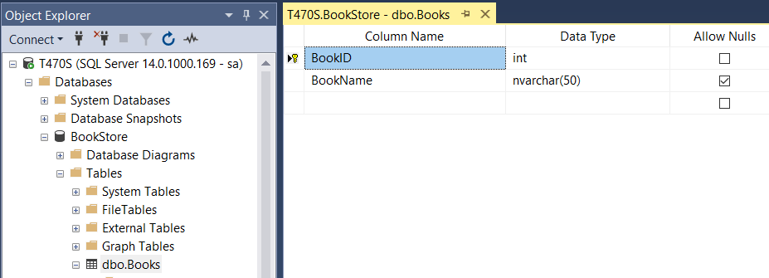
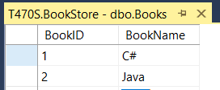
Demo BookStore

Slide 26
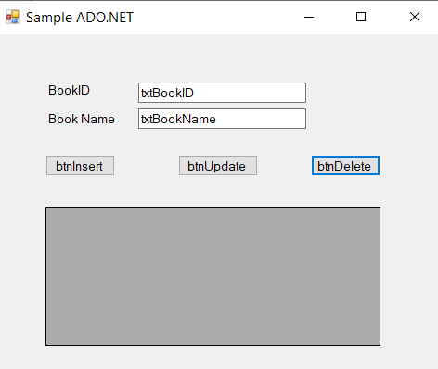
Demo BookStore
DataGridView Control
Name: dgvBookList

Slide 27
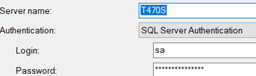
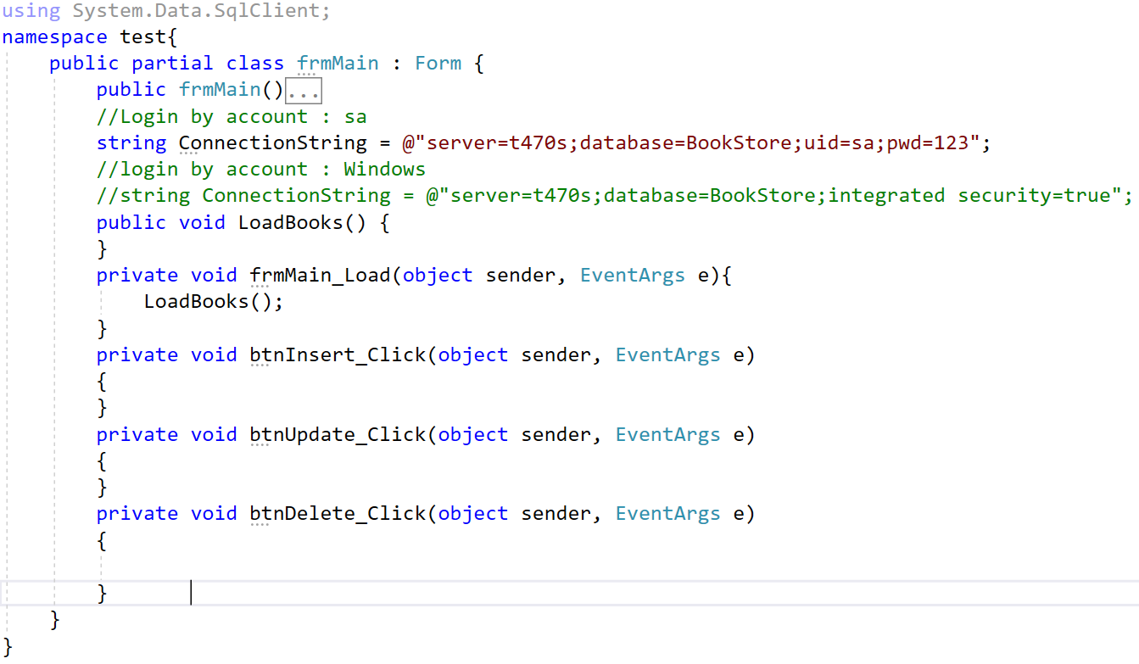

Slide 28
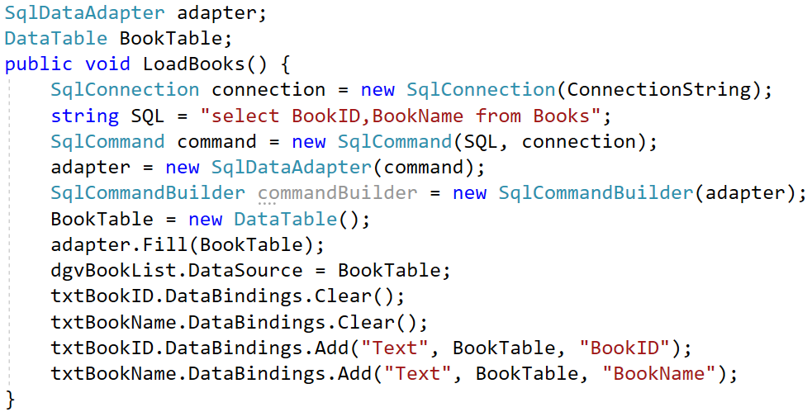
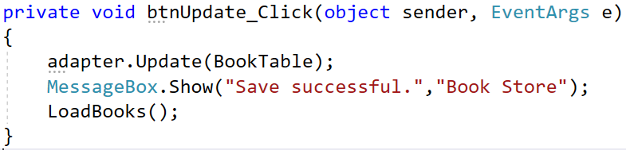
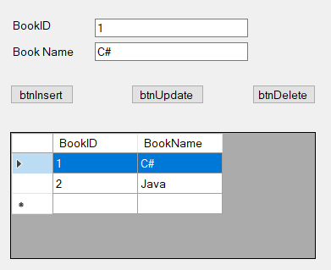

Slide 29
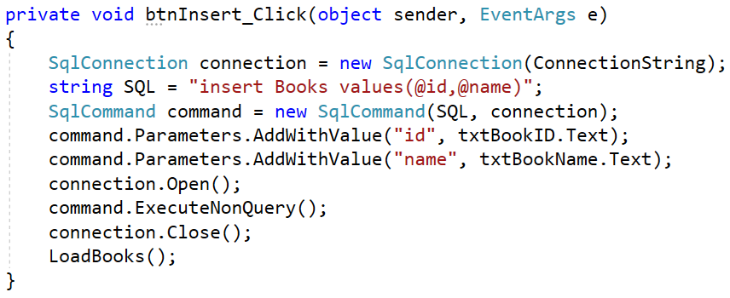
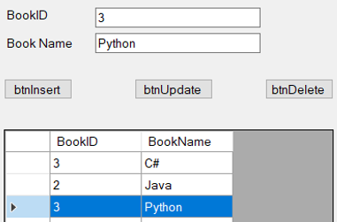

Slide 30
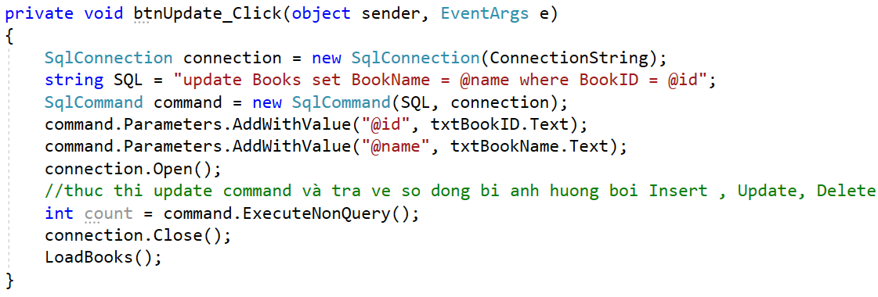
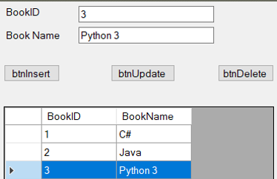

Slide 31
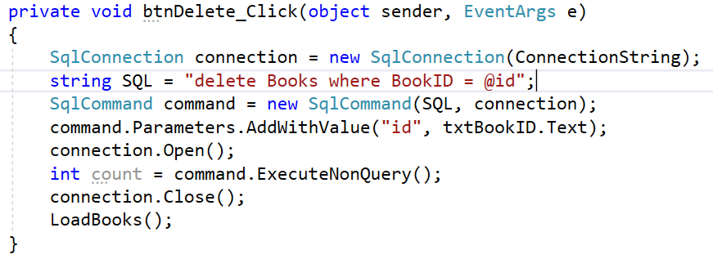
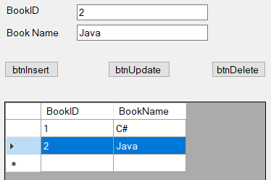

Slide 32
ADO.NET: Connected Layer
Data Readers
The DbDataReader type (which implements IDataReader) is the simplest and fastest way to obtain information from a data store.
Data readers represent a read-only, forward-only stream of data returned one record at a time.
Data readers are useful only when submitting SQL selection statements to the underlying data store.
Data readers are useful when you need to iterate over large amounts of data very quickly and have no need to maintain an in-memory representation.
Data reader objects (unlike data adapter objects) maintain an open connection to their data source until you explicitly close the session.
The Read()method to determine when the end of your records have been reached (via a false return value)

Slide 33
SQLDataReader
Demo BookStore

Slide 34
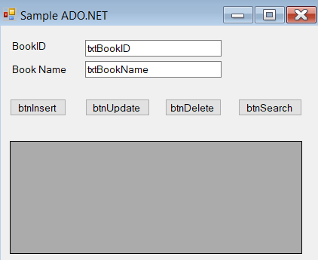

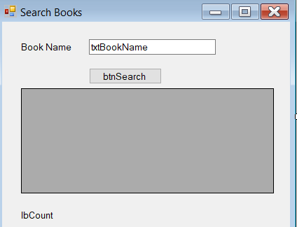
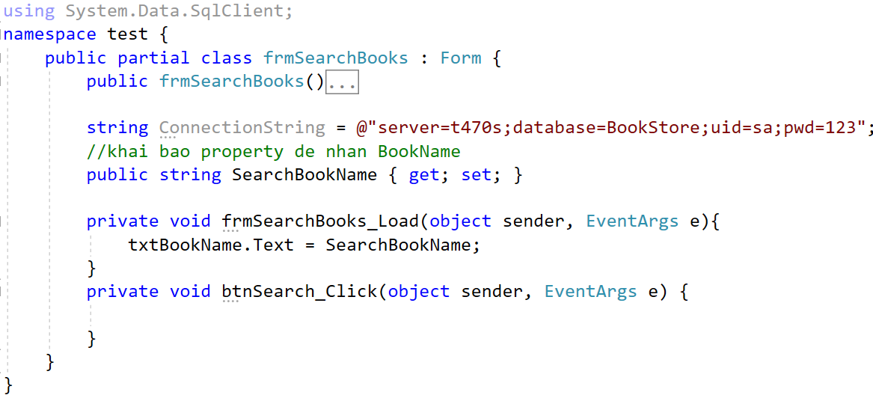
DataGridView Control
Name: dgvBookList

Slide 35
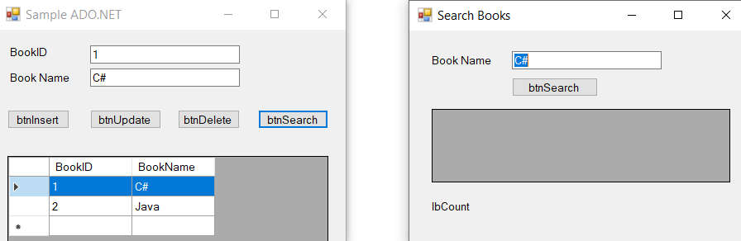
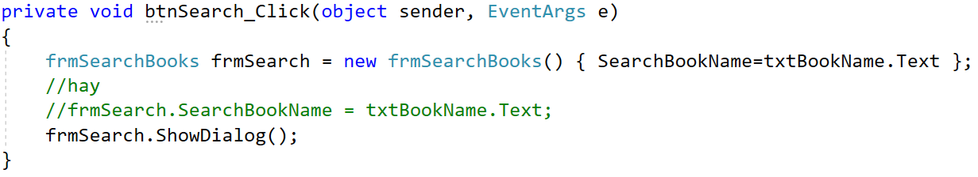

Slide 36
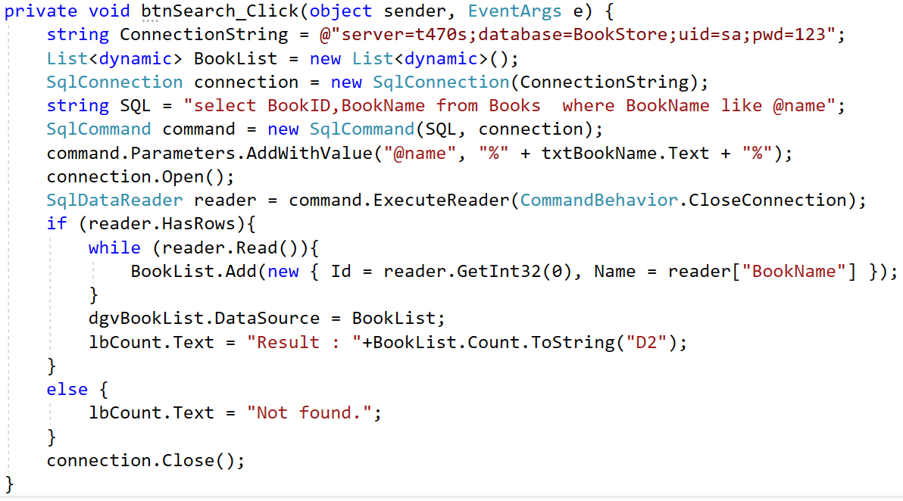
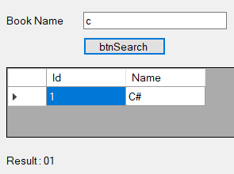

Slide 37
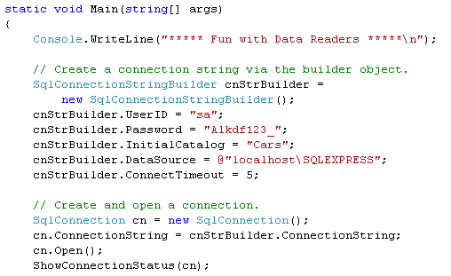
Connected Layer Demo
(Ch_22 Code\CarsDataReader)
Build connection information using SqlConnectionStringBuider

Slide 38
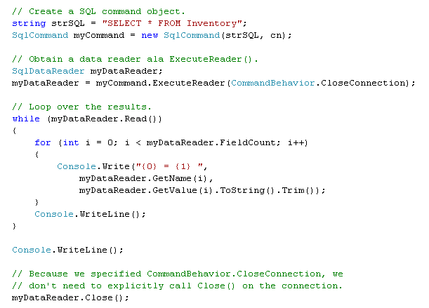
Connected Layer Demo (Ch_22 Code\CarsDataReader)
Create and execute query command
Read the returned records.

Slide 39
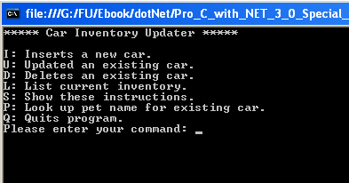
Modify tables Demo (Ch_22 Code\CarsInventoryUpdater)
Build a new console application (CarsInventoryUpdater)
that allows the caller to modify the Inventory table of the Cars database.
This program will allow the user to enter the following commands:
• I: Inserts a new record into the Inventory table
• U: Updates an existing record in the Inventory table
• D: Deletes an existing record from the Inventory table
• L: Displays the current inventory using a data reader
• S: Shows these options to the user
• Q: Quits the program

Slide 40
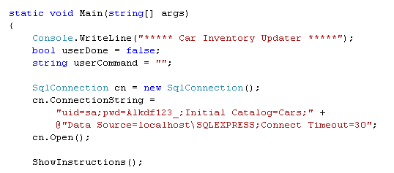
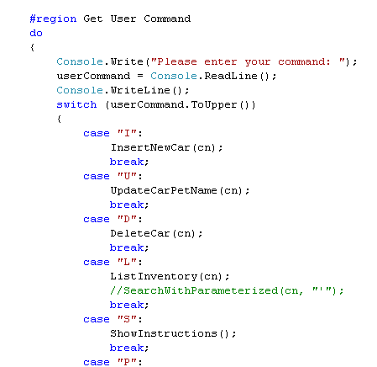
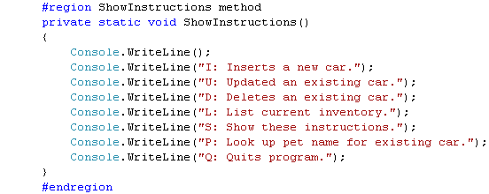
Modify tables Demo (Ch_22 Code\CarsInventoryUpdater)

Slide 41
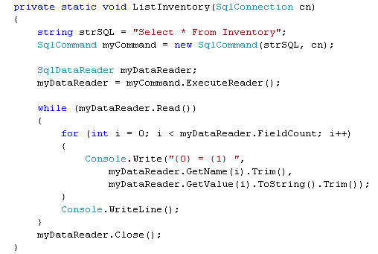
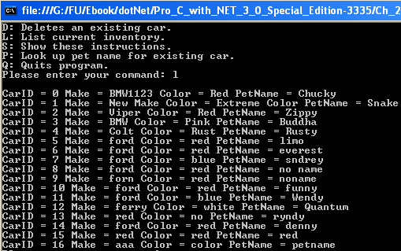
Modify tables Demo (Ch_22 Code\CarsInventoryUpdater)

Slide 42
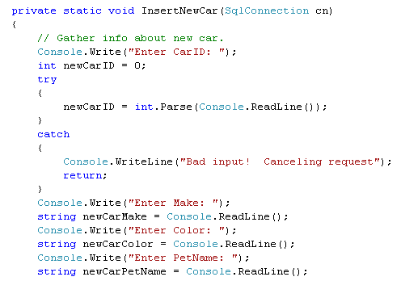
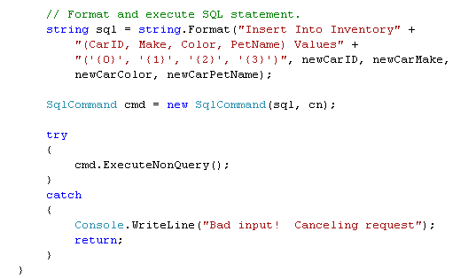
Modify tables Demo (Ch_22 Code\CarsInventoryUpdater)
Insert data

Slide 43
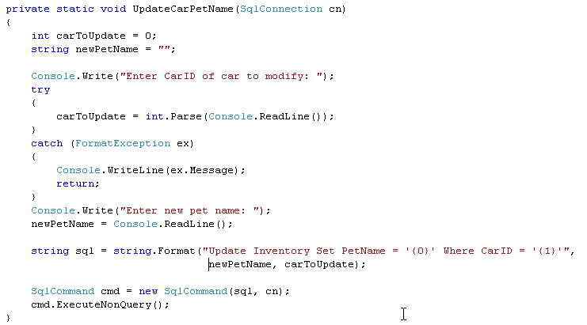
Modify tables Demo (Ch_22 Code\CarsInventoryUpdater)
Update data

Slide 44
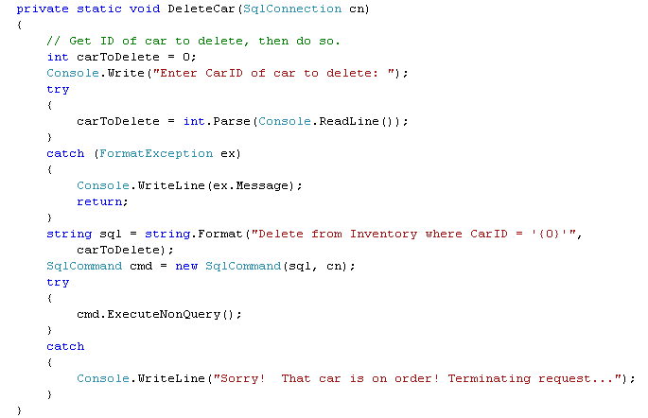
Modify tables Demo (Ch_22 Code\CarsInventoryUpdater)
Delete data

Slide 45
Working with Parameterized Command Objects
Building a SQL statement using string concatenation can be risky from a security point of view (ex: SQL injection attacks).
Parameterized queries execute much faster than a literal SQL string, in that they are parsed exactly once
To associate a parameter within a SQL query to a member in the command object’s parameters collection, prefix the SQL text parameter with an at (@) symbol
Property | Description
DbType | Gets or sets the native data type from the data source
Direction | Gets or sets whether the parameter is input-only, output-only, bidirectional, or a return value parameter
ParameterName | Gets or sets the name of the DbParameter
Value | Gets or sets the value of the parameter

Slide 46
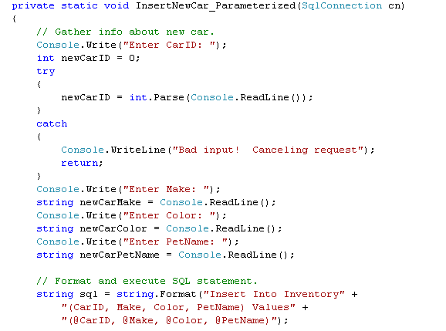
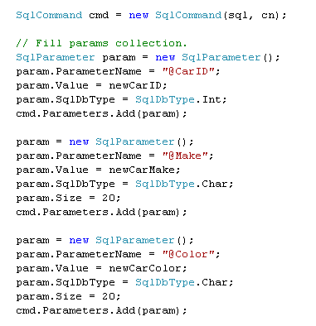
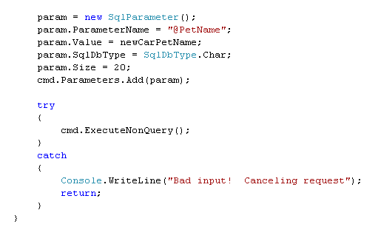
Parameterized Demo (Ch_22 Code\CarsInventoryUpdater)
Insert data using parameterized

Slide 47
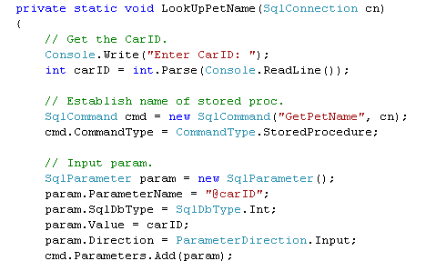
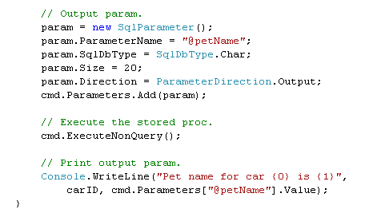
Parameterized Demo (Ch_22 Code\CarsInventoryUpdater)
Call store procedure
Input for store procedure
Output for store procedure

Slide 48
Call Store Procedure in ADO.NET
Demo BookStore

Slide 49
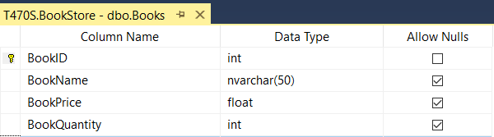
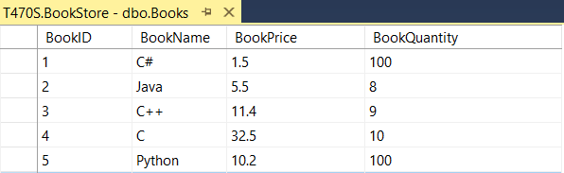
Thêm vào bảng Books 02 cột như sau :

Slide 50
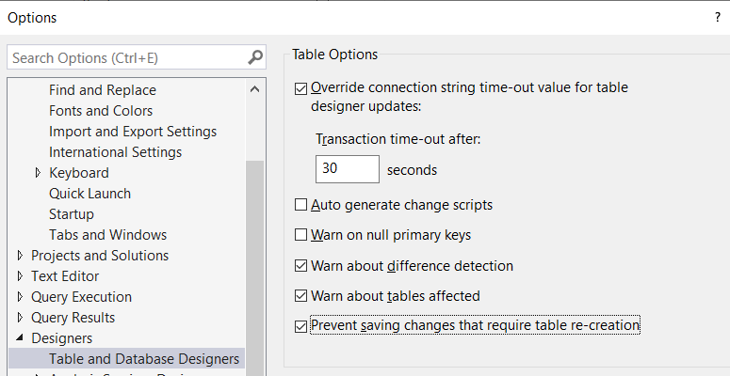
Cấu hình cho phép SQL Server lưu thay đổi khi thêm cột trong bảng

Slide 51
2. Chạy Script tạo 02 store procedure để lấy BookQuantity và BookPrice
Use BookStore
GO
Create Proc [spGetBookPriceByBookID](@BookID int, @Price float output ) AS
select @Price = BookPrice from Books
where BookID = @BookID
GO
Create Proc [spReturnBookQuantityByBookID]( @BookID int ) AS
declare @BookQuantity float
select @BookQuantity = BookQuantity from Books
where BookID=@BookID
return @BookQuantity

Slide 52

2. Chạy Script tạo 02 store procedure để lấy BookQuantity và BookPrice

Slide 53


Working with Parameterized Command Objects

Slide 54

Working with Parameterized Command Objects

Slide 55

Working with Parameterized Command Objects

Slide 56


Working with Parameterized Command Objects

Slide 57
Asynchronous Data Access Under .NET 2.0
The SQL data provider has been enhanced to support asynchronous database interactions via the members of SqlCommand:
BeginExecuteReader()/EndExecuteReader()
BeginExecuteNonQuery()/EndExecuteNonQuery()
BeginExecuteXmlReader()/EndExecuteXmlReader()
Enjoy yourself at HOME

Slide 58
ADO.NET: Disconnected Layer
Data adapter (which extends the abstract DbDataAdapter) is used to fetch and update data.
Data adapter objects make use of DataSet objects to move data between the caller and data source.
The DataSet type is a container for any number of DataTable objects, each of which contains a collection of DataRow and DataColumn objects.

Slide 59

ADO.NET: Disconnected Layer
Data adapter objects move DataSets to and from the client tier.
The data adapter handles the database connection automatically and keeps the connection open for the shortest possible amount of time.

Slide 60
ADO.NET: Disconnected Layer
Once the caller receives the DataSet object, the connection is completely disconnected from the DBMS and left with a local copy of the remote data.
The caller is free to insert, delete, or update rows from a given DataTable, but the physical database is not updated until the caller explicitly passes the DataSet to the data adapter for updating.

Slide 61

ADO.NET: Disconnected Layer
DataSet
A DataSet is an in-memory representation of external data.
A DataSet is a class type that maintains three internal strongly typed collections
Notes:
Given that a DataSet is a disconnected version of a database schema, it can programmatically represent
the parent/child relationships between its tables. For example, a relation can be created between
two tables to model a foreign key constraint using the DataRelation type. This object can then be
added to the DataRelationCollection through the Relations property

Slide 62
ADO.NET: Disconnected Layer
DataSet Elements
DataTableCollection can be accessed via Table property that contains the individual DataTables.
DataRelationCollection can be accessed through the Relations property.
A relation can be created between two tables to model a foreign key constraint using the DataRelation type.
PropertyCollection: can be accesed via ExtendedProperties that allows to add any extra information to the DataSet as name/value pairs.

Slide 63

Demo Disconnected Layer

Slide 64

Demo Disconnected Layer

Slide 65


Demo Disconnected Layer

Slide 66
Disconnected Layer Demo (Ch_22 Code\CarsInvertoryUpdaterDS)
Build a new console application (CarsInventoryUpdater)
that allows the caller to modify the Inventory table of the Cars database.
This program will allow the user to enter the following commands:
• I: Inserts a new record into the Inventory table
• U: Updates an existing record in the Inventory table
• D: Deletes an existing record from the Inventory table
• L: Displays the current inventory using a data reader
• S: Shows these options to the user
• Q: Quits the program

Slide 67

Disconnected Layer Demo (Ch_22 Code\CarsInvertoryUpdaterDS)

Slide 68

Disconnected Layer Demo (Ch_22 Code\CarsInvertoryUpdaterDS)
List all data in the data set

Slide 69


Disconnected Layer Demo (Ch_22 Code\CarsInvertoryUpdaterDS)
Insert data to database
Add new row in the data set
Update dataset to database

Slide 70


Disconnected Layer Demo (Ch_22 Code\CarsInvertoryUpdaterDS)
Update data to database
Update row in dataset
Update dataset to database

Slide 71

Disconnected Layer Demo (Ch_22 Code\CarsInvertoryUpdaterDS)
Delete data from database
Delete in dataset
Update dataset to database

Slide 72
Autogenerating SQL Commands Using Command Builder Types
.NET 2.0 provides a command builder to automatically obtain command objects that contain the correct Insert, Delete, and Update command types based on the initial Select statement

Slide 73


Command Builder Demo (Ch_22 Code\MySqlCommandBuilder)

Slide 74


Binding data to DataGridView control
Notes:
Tạo 1 database tên Cars gồm 1 bảng Inventory có 4 Column
CarID : int
Make : varchar
Color : varchar
PetName : varchar

Slide 75


Binding data to DataGridView control

Slide 76


Binding data to DataGridView control

Slide 77

Binding data to DataGridView control

Slide 78

Binding data to DataGridView control

Slide 79


Binding data to DataGridView control
Click event

Slide 80


Binding data to DataGridView using VS 2005 Wizard
1
2

Slide 81


Binding data to DataGridView using VS 2005 Wizard
3
4

Slide 82


Binding data to DataGridView using VS 2005 Wizard
5
6

Slide 83

Binding data to DataGridView using VS 2005 Wizard
7

Slide 84


8

Slide 85

Binding data to DataGridView using VS 2005 Wizard
9

Slide 86
Summary
ADO vs ADO .NET
The .NET 2.0 Provider Factory Model
Understanding the Connected Layer of ADO.NET
Working with Parameterized Command Objects
Understanding the Disconnected Layer of ADO.NET: DataAdapter / DataSet
Binding DataTables to User Interfaces.

Slide 87
Chapter 22: Q & A

